Slide 2
Notes:
Edutopia film

Slide 3
Notes:
logo

Slide 4
Persistence of a Vision
Need an Idea

Slide 5
Persistence of a Vision
Need an Idea
That Idea Comes from…

Slide 7
I come from a family of all boys.

Slide 8
Notes:
3 brothers and me

Slide 9
Johnny

Slide 11
Persistence of a Vision
*Need an Idea
Your Passion and Purpose
Make Your Own Opportunity

Slide 31
Persistence of a Vision
*Need an Idea
Your Passion and Purpose
Make Your Own Opportunity
Ask for your opportunity

Slide 32
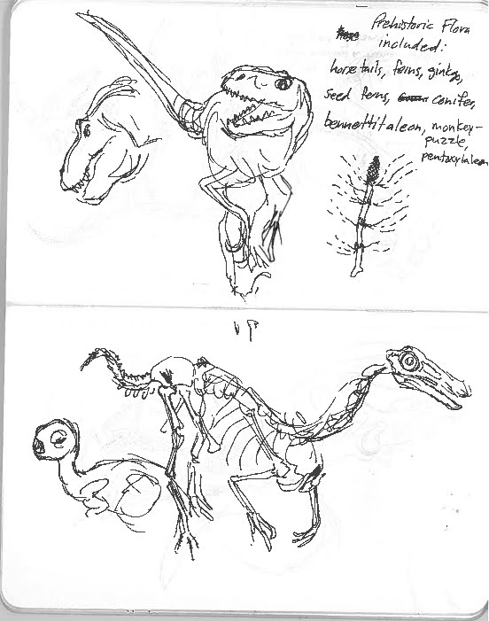
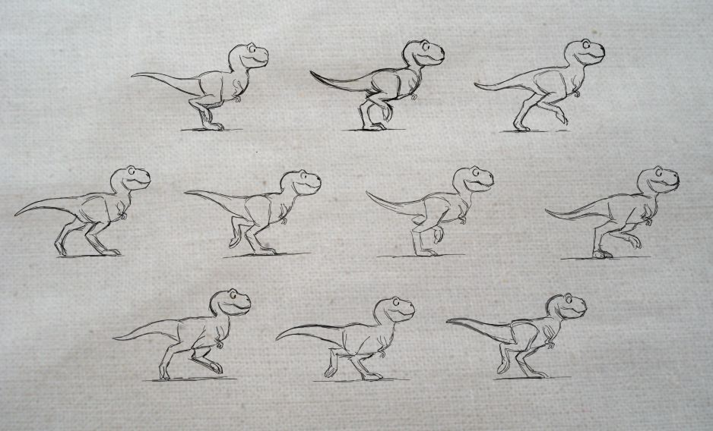

Slide 33
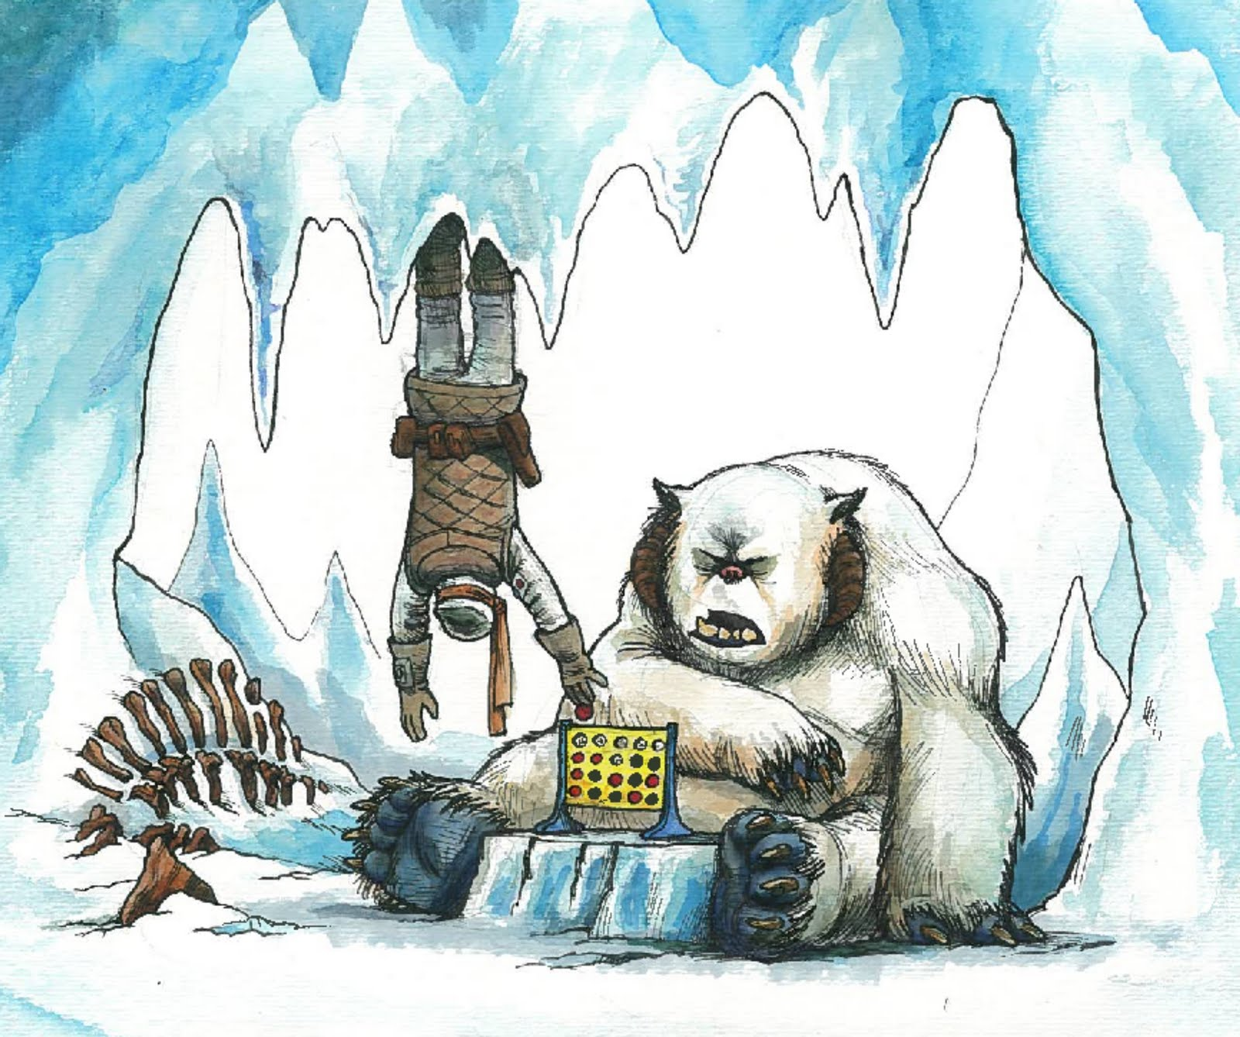

Slide 35
Austin Madison

Slide 36
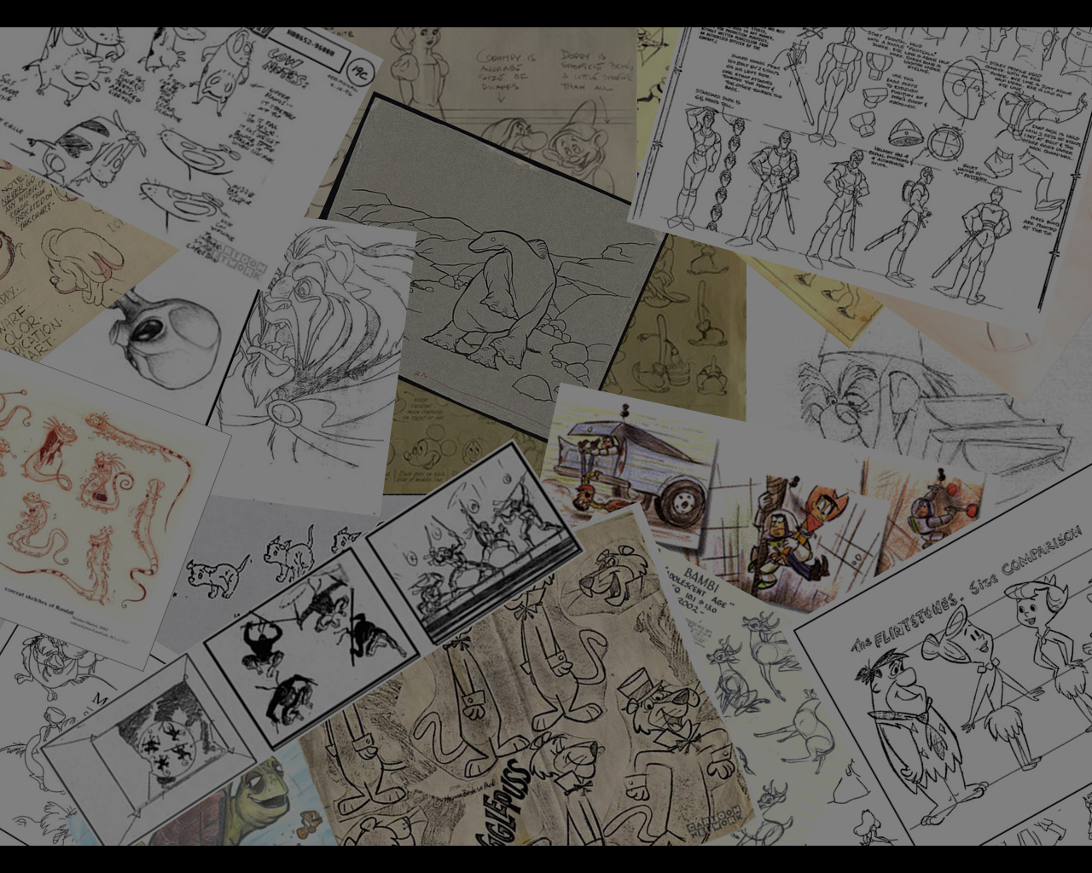
Provide a Real World Experiences
World is Smaller
Share your passion
Create your own internships
Notes:
Real world experience – talk about your experiences k9, cal arts, csssa
World is small talking point – blogs, youtube 11 second club, …
Share passion – go and meet people in your area. They give talks, lectures art shows openings
Create your own internship – talk about the idea of naild

Slide 37
Persistence of a Vision
*Need an Idea
Your passion and purpose
*Make Your Own Opportunity
Ask for your opportunity
Know Your Students

Slide 38
Camping

Slide 54
The boat rack story is too graphic to illustrate.

Slide 75
Many years later

Slide 76
My friends

Slide 77
Lets go camping.

Slide 83
1.7 miles turn East. 2.3 miles turn north…

Slide 84
Boulder with the moss turn left. Tree that looks like an alter turn right…

Slide 85
Doesn’t matter just go!

Slide 86
Seeing things differently

Slide 90
Persistence of a Vision
*Need an Idea
Your passion and purpose
*Make Your Own Opportunity
Ask for your opportunity
Know Your Students
Learn about Your Learners

Slide 91
Your Persistence of a Vision

Slide 92
Your Persistence of a Vision

Slide 93
Persistence of a Vision
*Need an Idea
Your passion and purpose
*Make Your Own Opportunity
Ask for your opportunity
*Know Your Students
Learn about Your Learners
Artist are Thieves
Don’t reinvent the wheel

Slide 95
Notes:
logo

